Slide 1
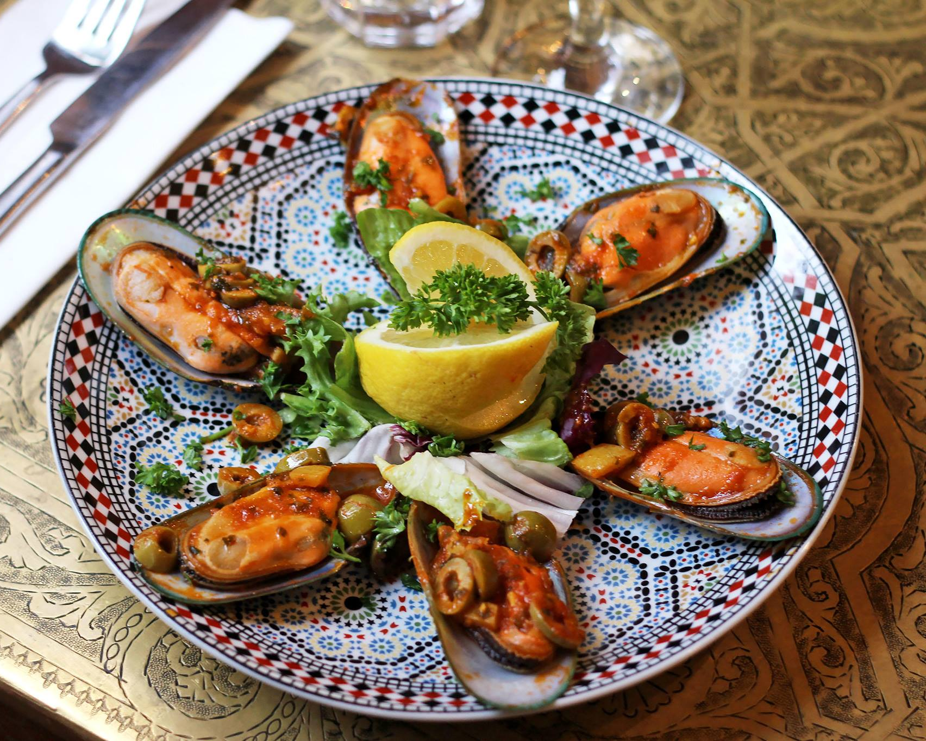
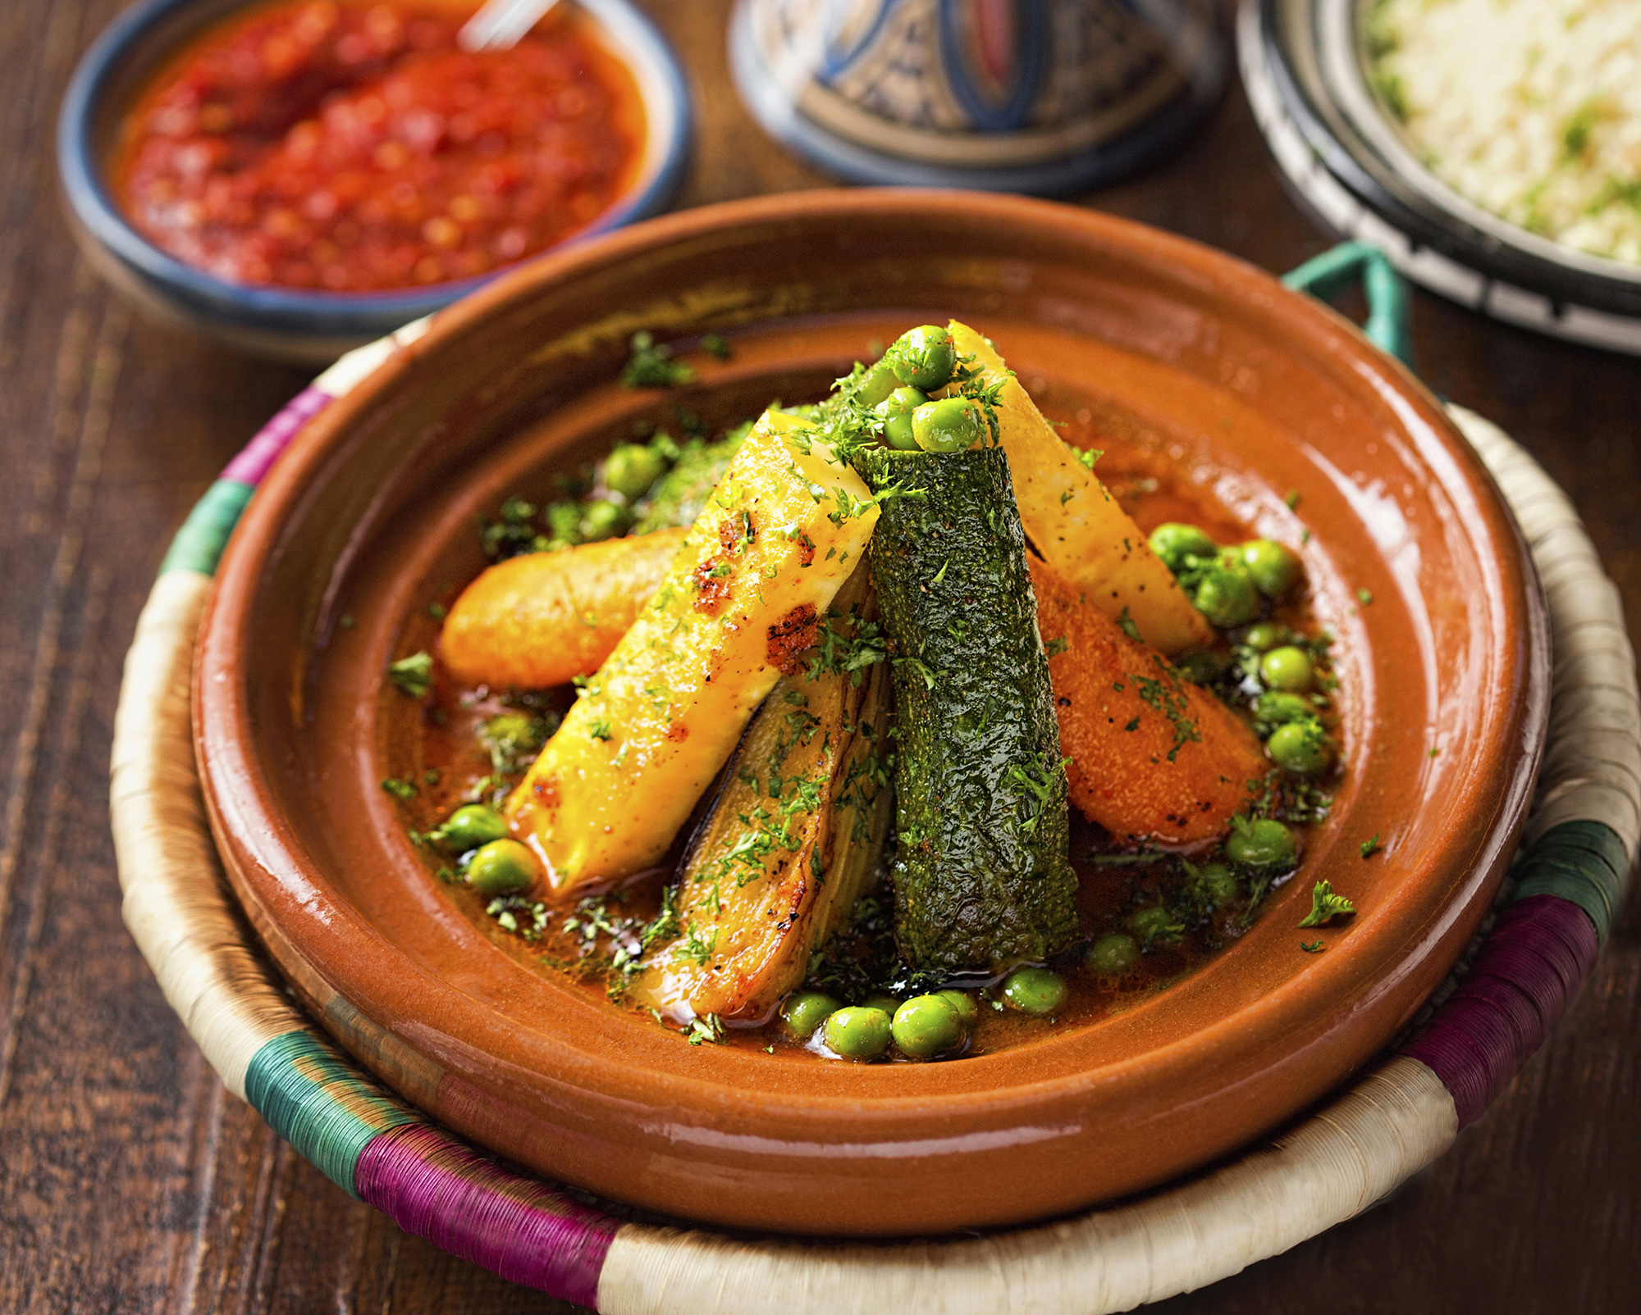
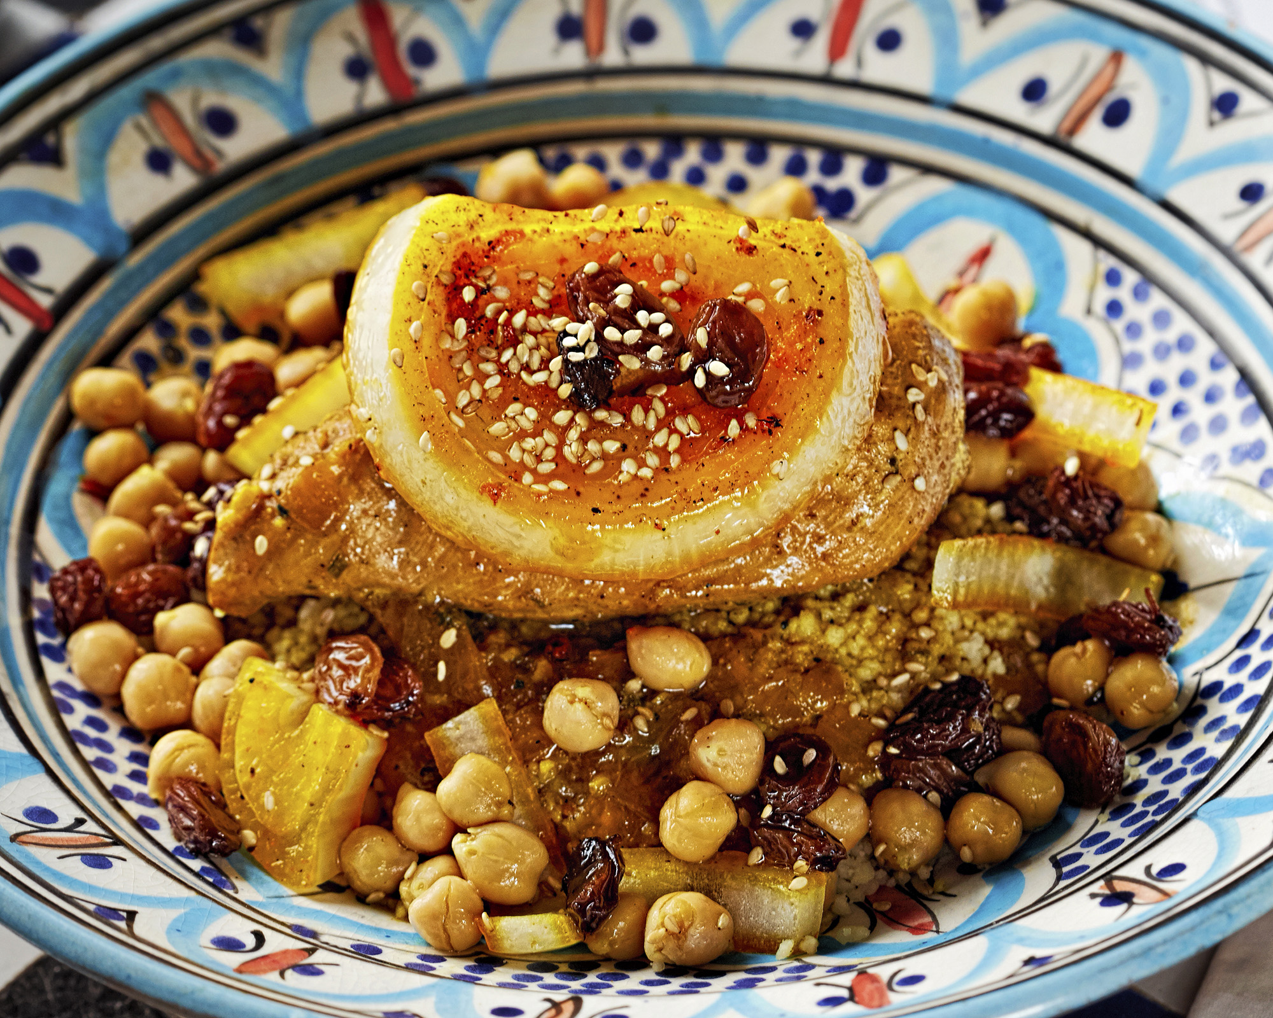
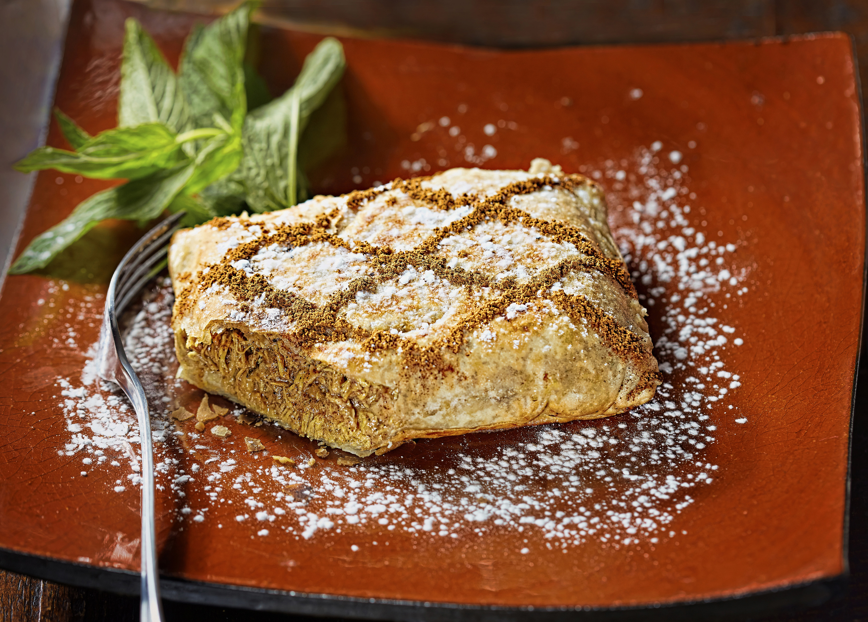
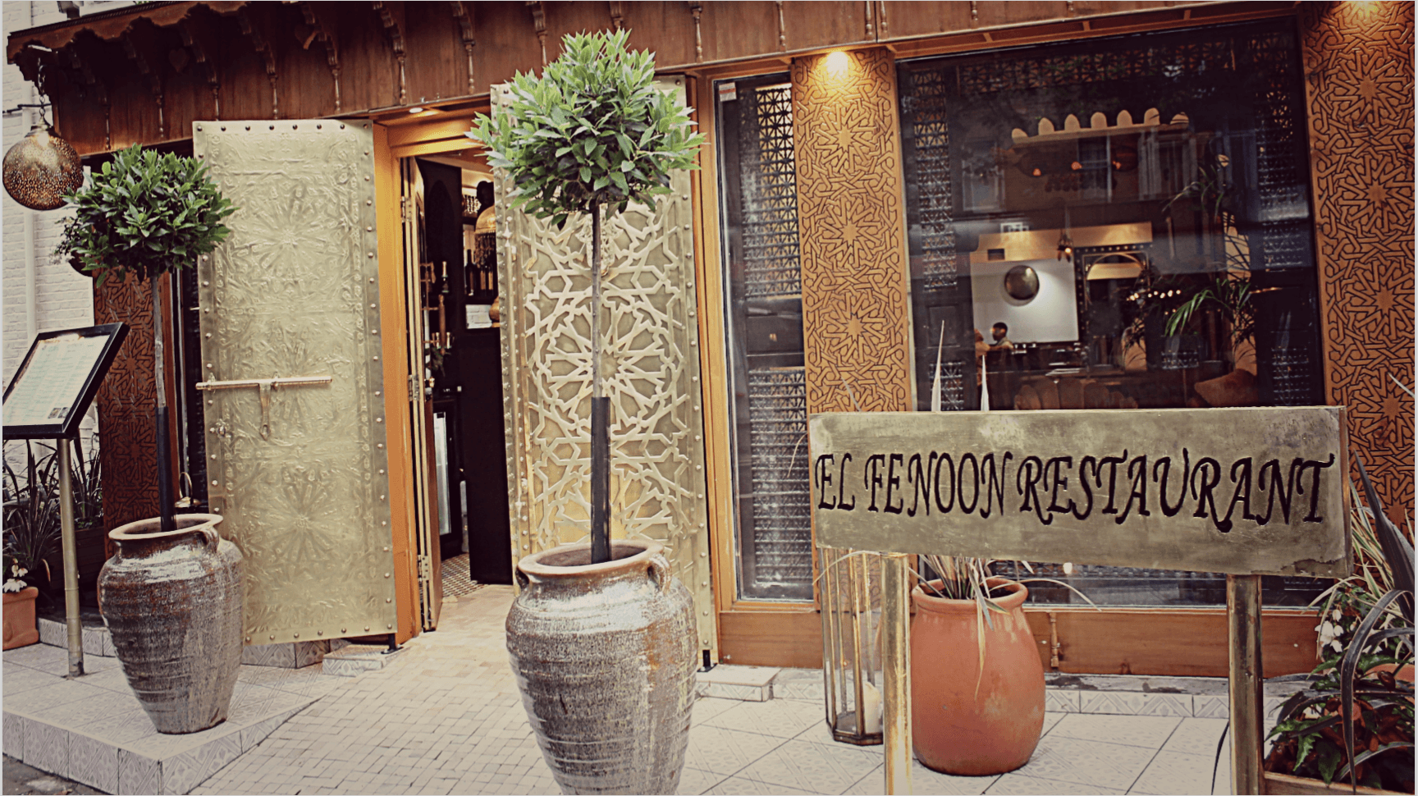
Welcome to ELFENOON
MOROCCAN RESTAURANT
0208 948 8275
www.elfenoon.co.uk
info@elfenoon.co.uk
149 Kew Road
Richmond
TW9 2PN

